Slide 1
Commerce Bank Project
Coy Kwan - Project Manager
Cori Mroz - Fullstack
Anna Johnson - Database/Backend
Feng Zheng - Fullstack/testing
Daylan Quinn - Front End

Slide 2
Tech Stack
Python
Django
HTML
CSS
Bootstrap
MySQL

Slide 3
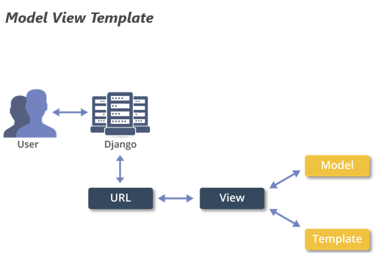
Django Recap
Model -> View -> Template hierarchy
Models for database abstraction, views for middleware/api, templates for front end
Provides admin tool for quick data visualization, manipulation for manual testing and added functionality.

Slide 4
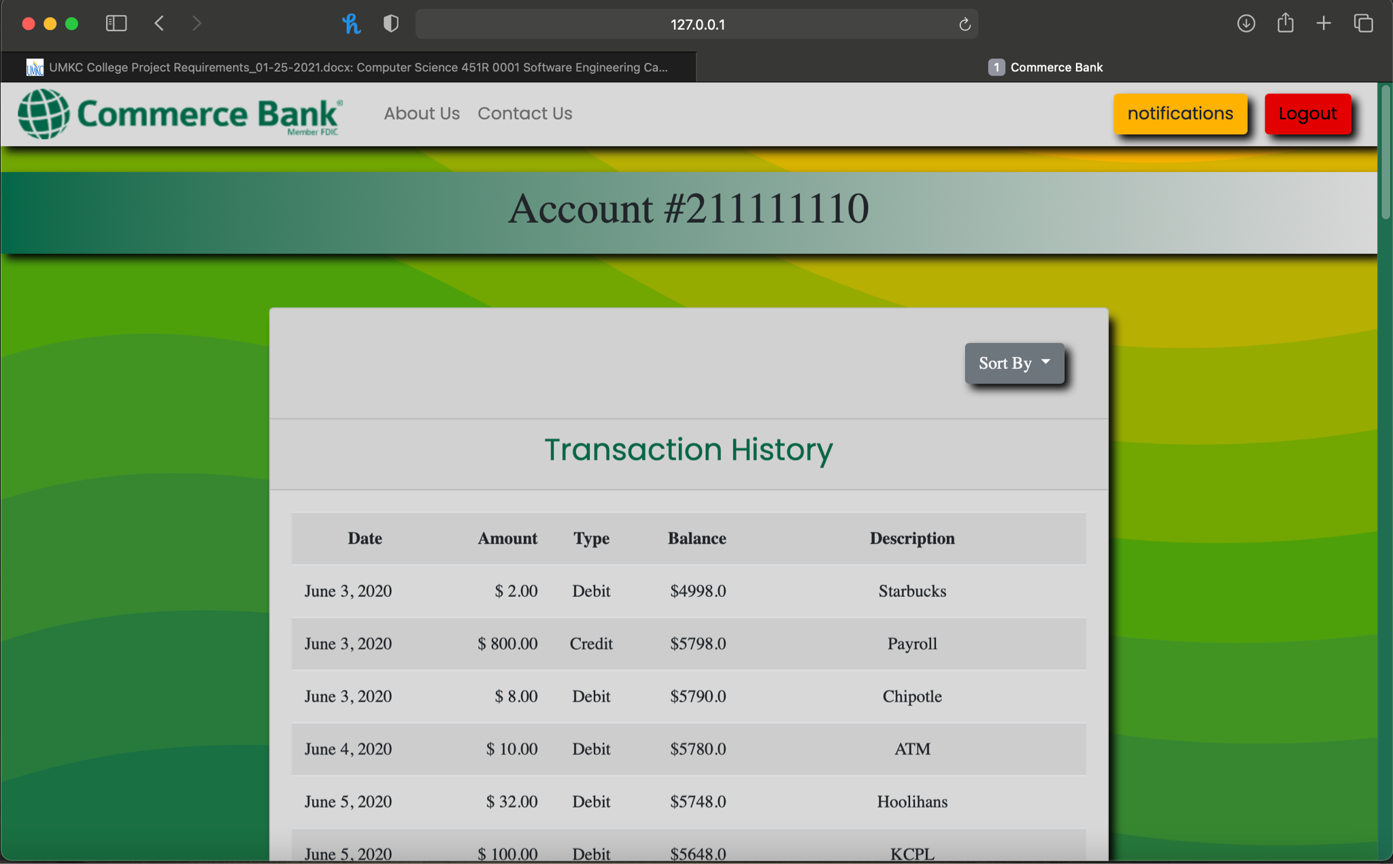
Dashboard
General transaction information
Ability to retroactively sort transactions by any of the notification rules
Access to notification settings

Slide 5
Notification Center
Three basic rules
When money is deposited
When account drops below a threshold set by a user
When a withdrawal exceeds a threshold
Notifications are set via email
Emails currently only “sent” locally however can be provided with a SMTP port for true functionality (All the decent email servers we found cost money)
EMAIL_BACKEND =
‘django.core.mail.backends.smtp.EmailBackend’
EMAIL_HOST = ‘smtp.gmail.com’
EMAIL_USE_TLS = True
EMAIL_PORT = 12345
EMAIL_HOST_USER = ‘your_account@gmail.com’
EMAIL_HOST_PASSWORD = ‘your account’s password’

Slide 6
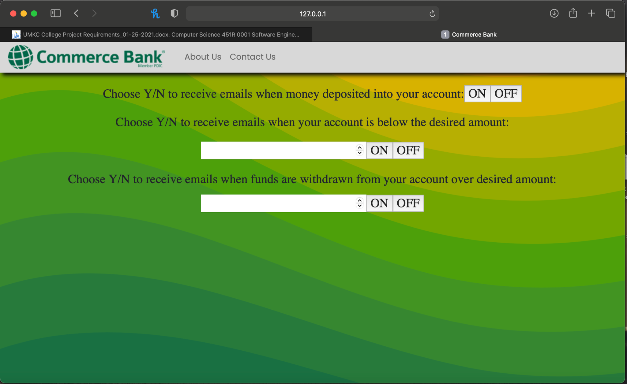
Notification Center

Slide 7
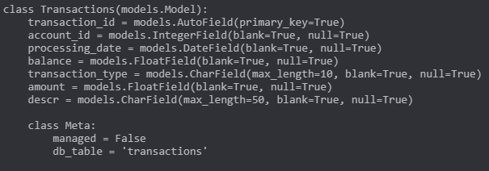
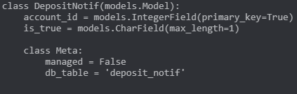
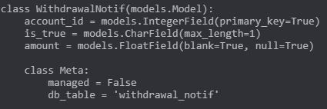
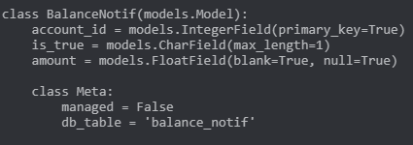
Database
Utilizing a MySQL database. Tables for:

Slide 8
Database and Middleware
Data represented in DDL like models in Django’s MVT structure
Views handle the logic allowing front end, templates, to talk to database
HTTP GET and POST requests
Rapidly speeds up development times

Slide 9
Security
Django natively protects against
Cross site scripting
Request forgery using built in secret keys for HTTP requests
MVT protects against SQL injection to an extent
Measures we have taken
Completely parameterized queries - no raw sql
Inputs heavily restricted

Slide 10
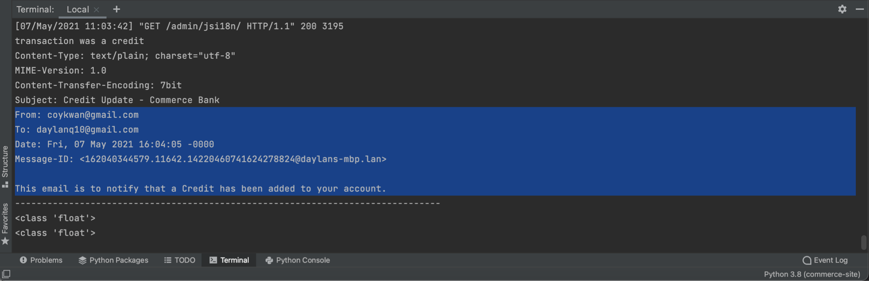
Stretch Goals
Github used for source control
Pull requests performed to combine all of the different pieces into the main branch
Code review done throughout design process
Notifications sent via email

Slide 11
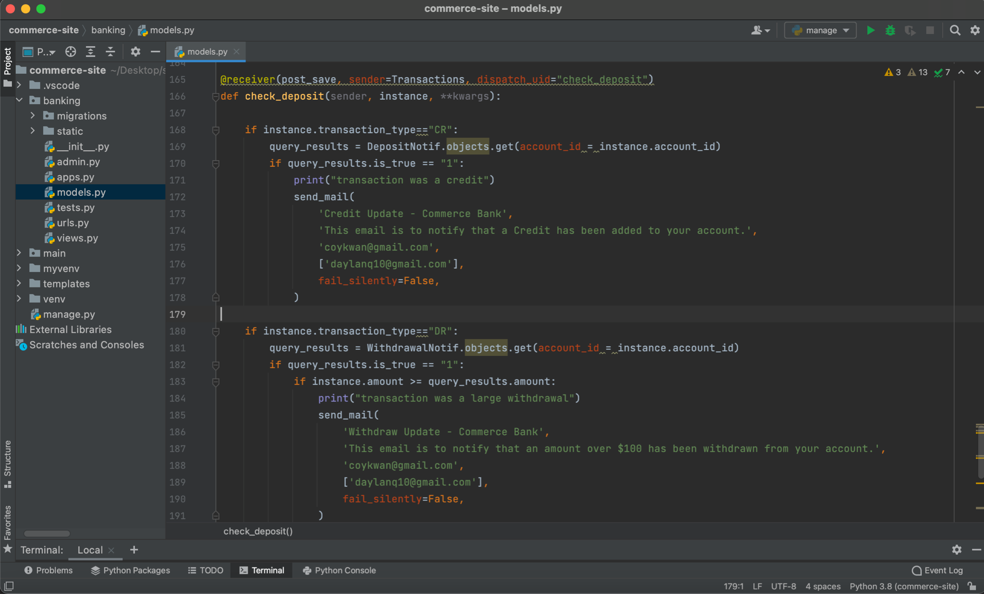
Email Notification Code

Slide 12
Live Demo
https://umkc.hosted.panopto.com/Panopto/Pages/Viewer.aspx?id=80a8921c-8c15-4fb3-8a3d-ad210117303d

Slide 13
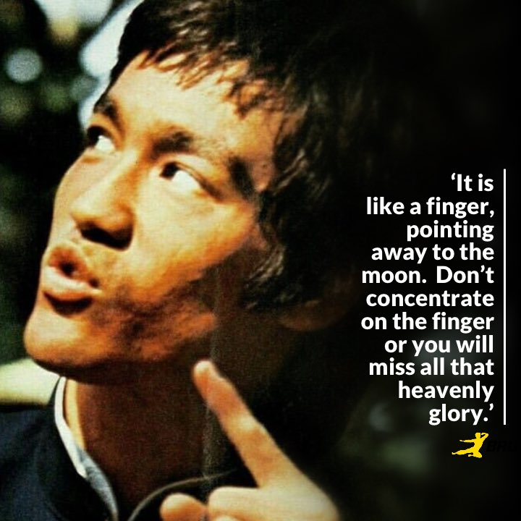
Risks and lessons learned
HTTP requests are a hard concept for first and second time users even with built in view API
This should've been attacked much earlier
Division of functionality would allow for faster and easier development
Initial planning of a hyper mobile friendly single page responsive design did not lend itself well to division of labor
If you spend too much time thinking about a think you’ll never get it done
Planning is great but action is better
Slow and steady wins the race

Slide 14
Questions?

